Slide 1
Video Game Sales
IST 718 Big Data
Sean Middleton, James Eakins
Richard Bump, Jonathan Ortiz

Slide 2
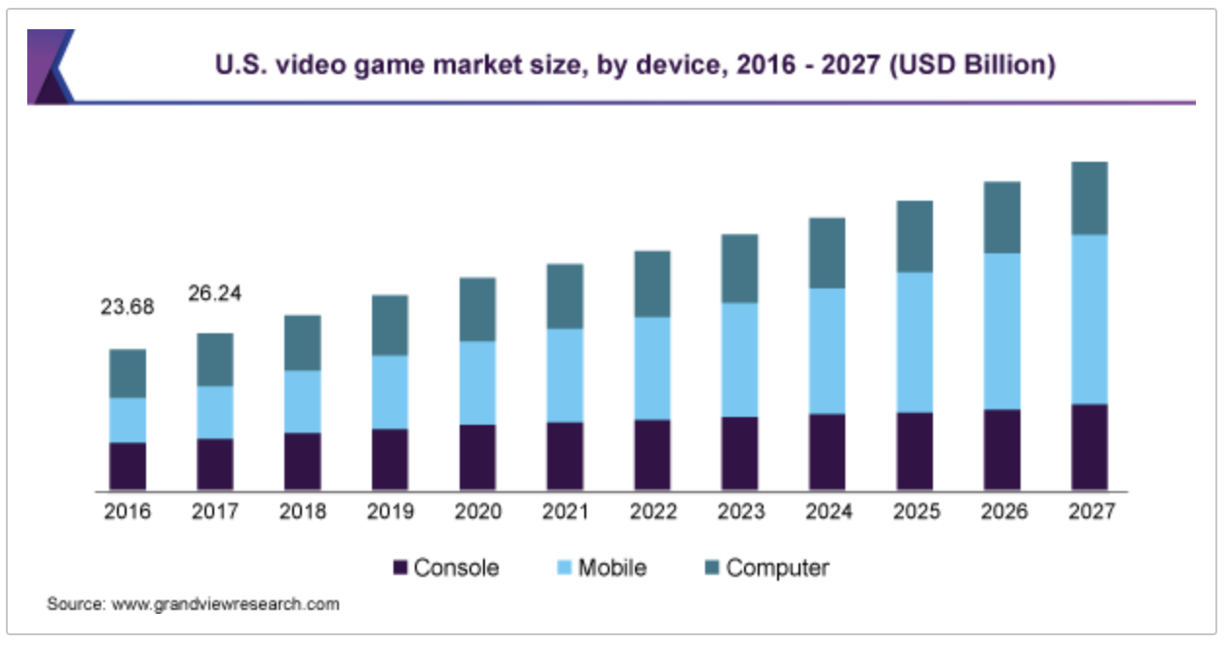
Background
In 1972, the phenomenon known as video games began with a simple game called pong. Video games are now a multi-billion industry, with estimations of 125 billion dollars, this does not include brand deals, tournament winnings, and social media influencer pay. The industry is growing at a rate of 12.9%, and a single game could bring in billions of dollars annually (Fortnite). Because of this it is important that companies can predict these sales, and understand what their customers are going to buy.

Slide 3
Table of Contents
S - Specify
Problem Statement, Data Questions, Objectives
O - Observe
Exploratory Data Analysis
A - Analyze
Naive Bayes, Linear Regression, Logistic Regression, Random Forest
R - Recommend
Answers to Data Questions, Conclusion Summary, Room for Improvements

Slide 4
Specify
Specifically, the questions we are trying to answer are:
Can we accurately predict the global sales of a game?
Can we predict whether a game will sell above or below the median price?
What is the best model to predict global sales of games?
Which platform will produce the most future Sales?

Slide 5
Data Transformation
Created dummy variables for Genres and Platform
Binned continuous User Scores to follow an ABCDF rating
Created a new binary variable above or below median price (Average price was attempted but only 1% is above the average price)
Removed non-statistically significant variables above .05 for the regression models
Changed Platform to Numbers
Grouped similar platforms into condensed groups (i.e. PS, PS2, PS3, PS4, PSP and PSV into PS)

Slide 6
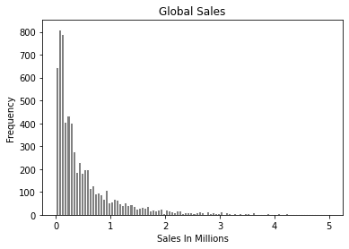
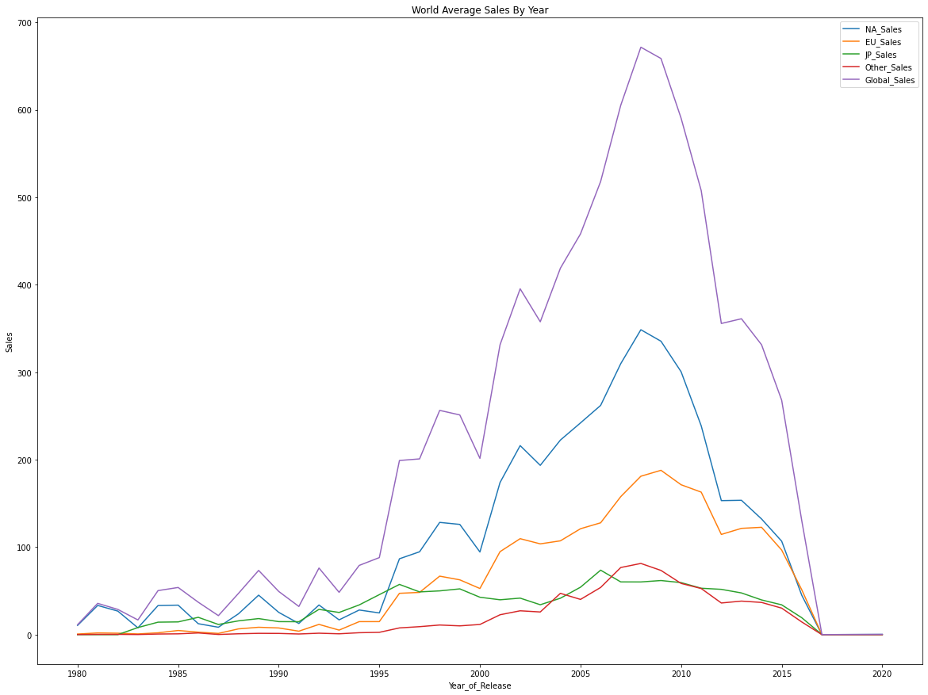
Observe : Sales
Most games do not sell well, while a few games sell incredible amounts, right skewed
Our sales data in 2009 show declines, and only goes until 2016, the actual trend during this time is upward
This may be due two things:
Less major platforms
Rise of mobile gaming

Slide 7
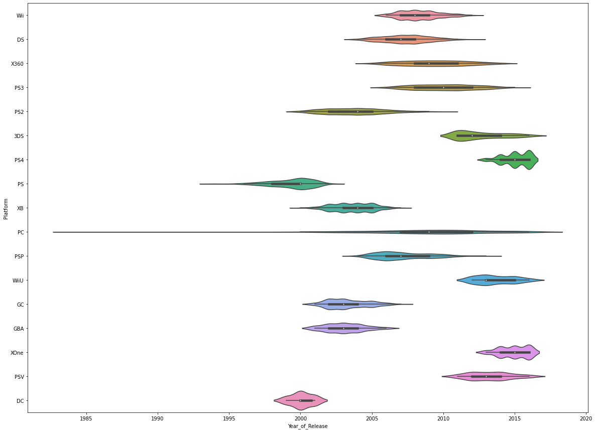
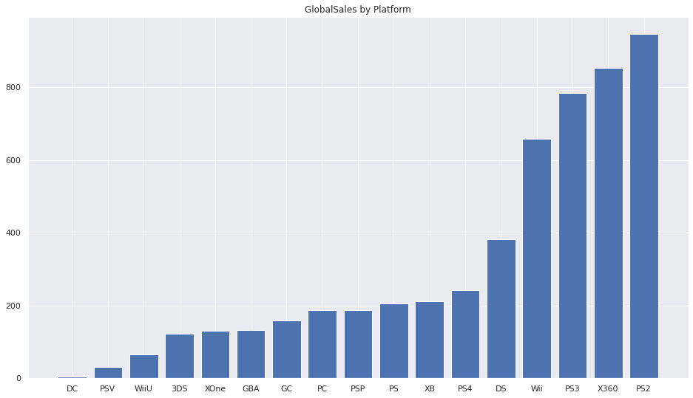
Observe : Platforms
There is some overlapping in time, but for the most part Platforms have their era’s
However, PC gaming is the most consistent platform over time.
The PS2 has more sales in our data set, but not every game is in our data set. This may cause some bias.
Notes:
.

Slide 8
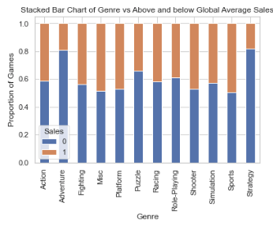
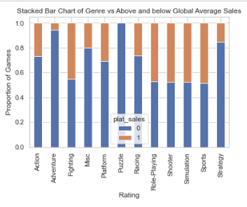
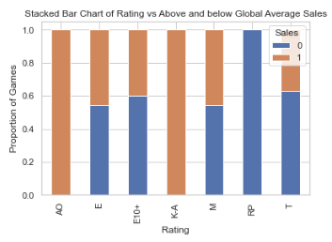
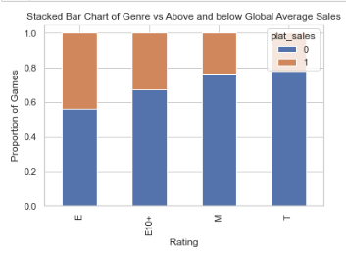
Observe: Variable Relationships
A few independent variables look as if they will have more of an impact than others in general. This becomes even more apparent when you look at it by platform

Slide 9
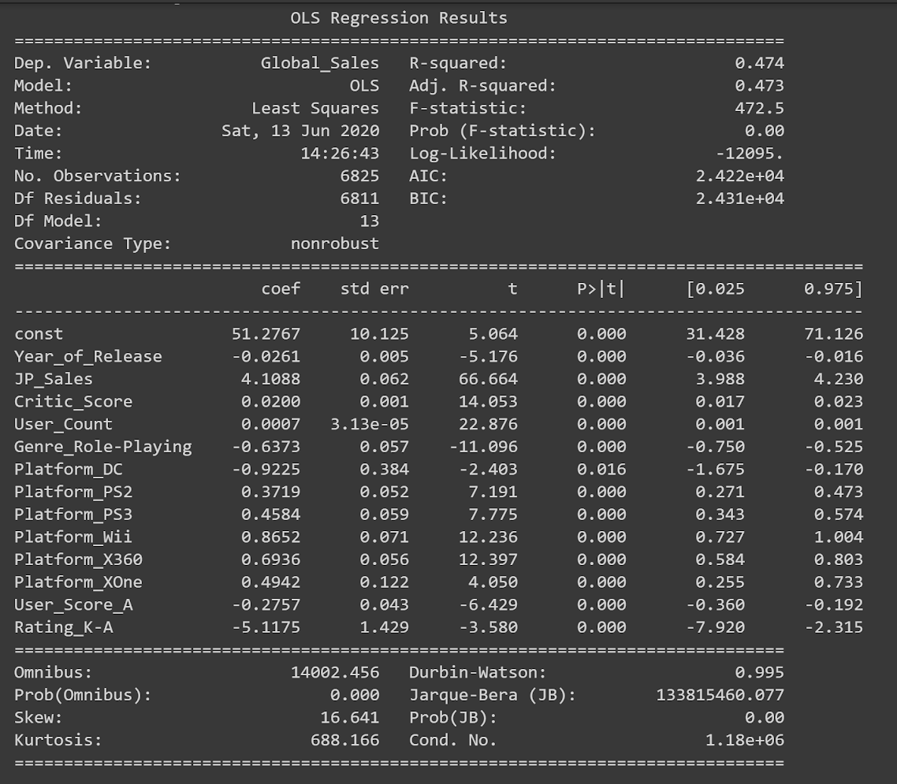
Analyze : Linear Regression
Top 3 Platforms : Wii, Xbox1, Xbox 360
R squared : .47
Most influential factor is the Rating of K-A
MAE : .6
MSE : 2.03

Slide 10
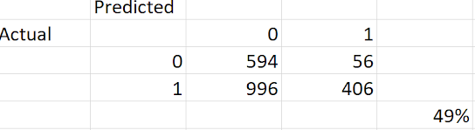
Analyze : Naive Bayes
The Naive Bayes has a 49% accuracy in determining whether a game will be above or below the median

Slide 11
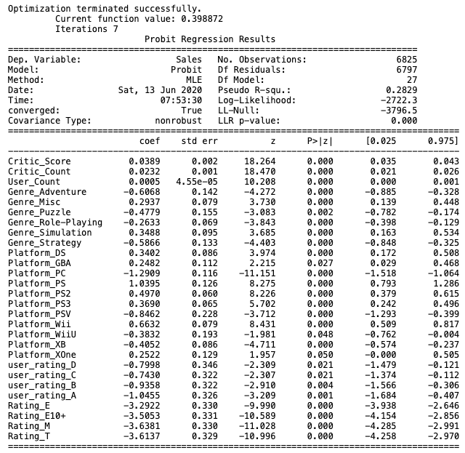

Analyze : Logistic Regression
R squared: .398
Most influential factors are the Game Ratings

Slide 12
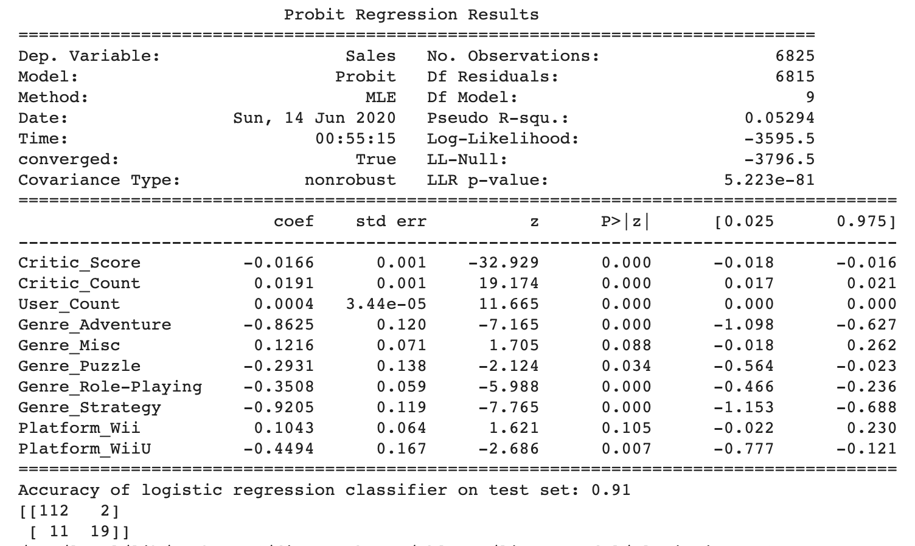
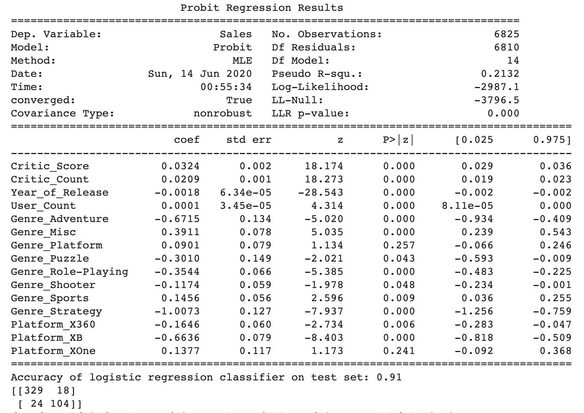
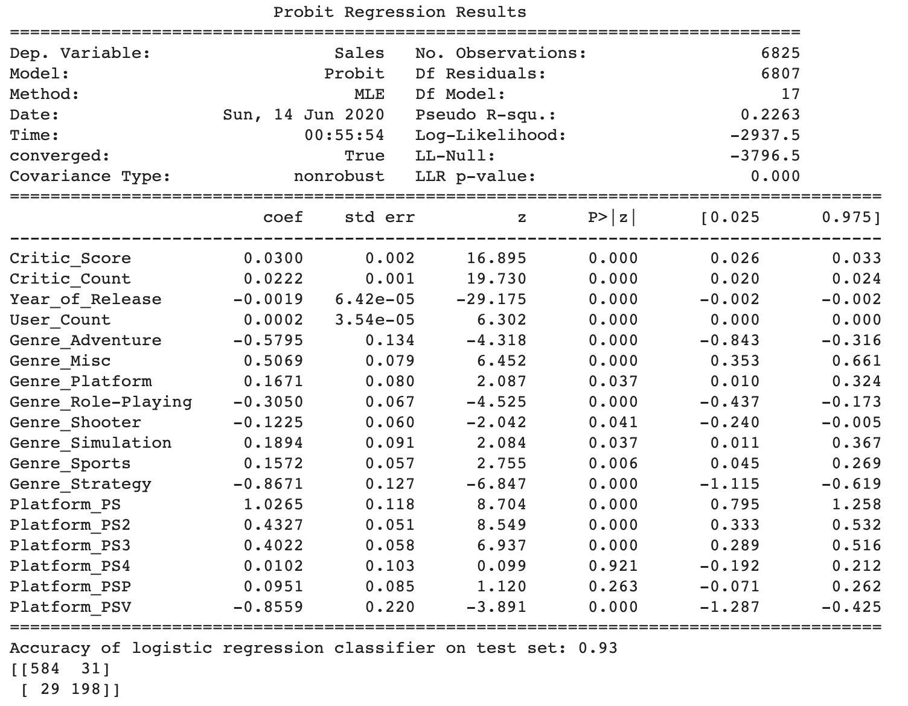
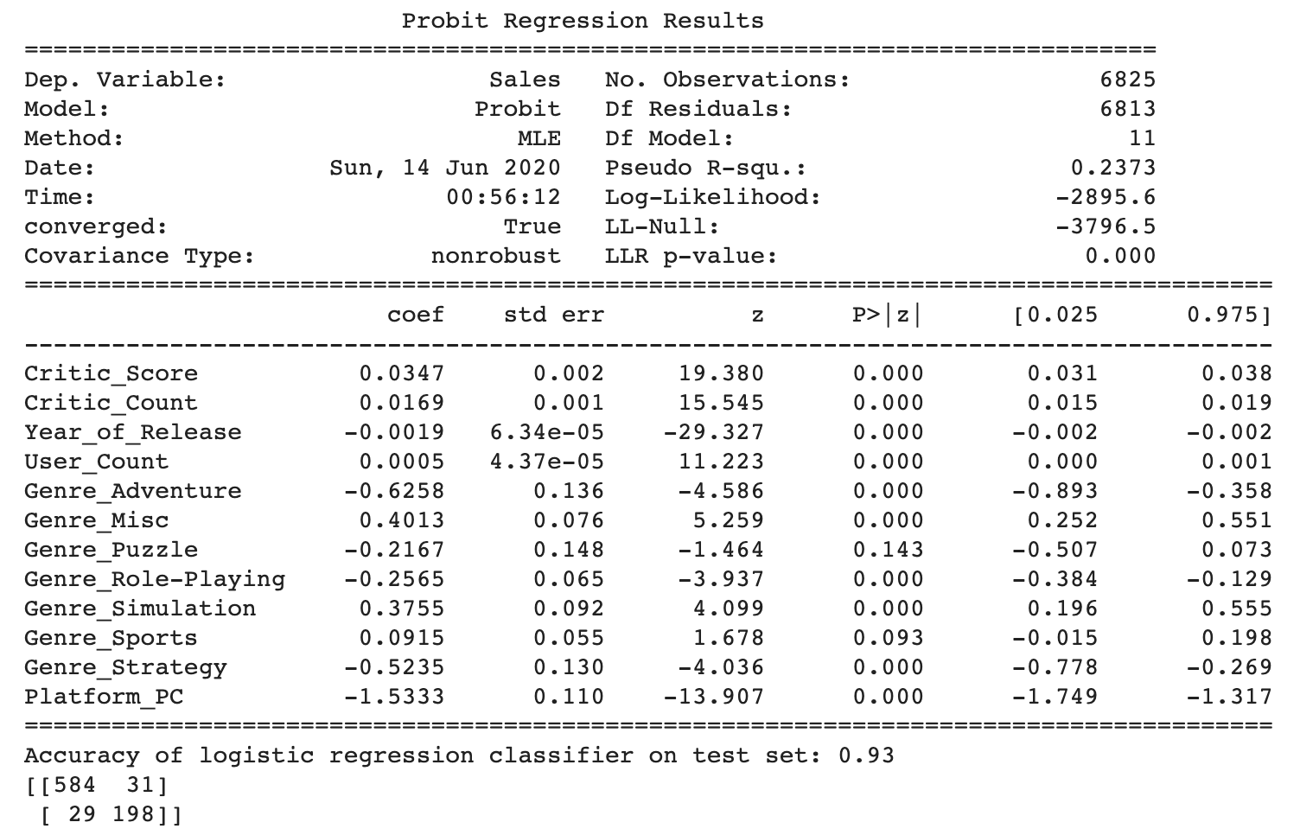
Analyze: Logistic Regression by Platform Group
Platform Groups Accuracy
Wii - 91%
Xbox - 91%
Playstation - 93%
PC - 93%
*Genres perform differently in different platform groups.

Slide 13
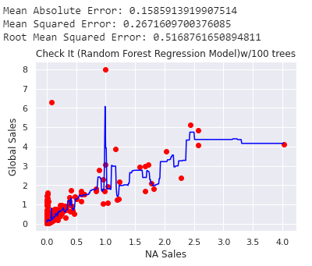
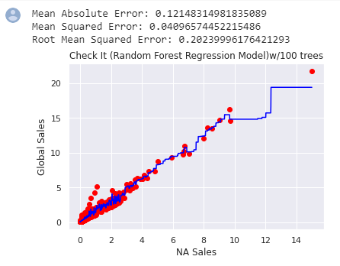
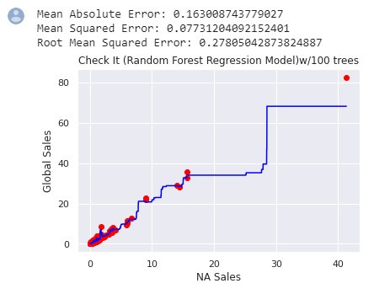
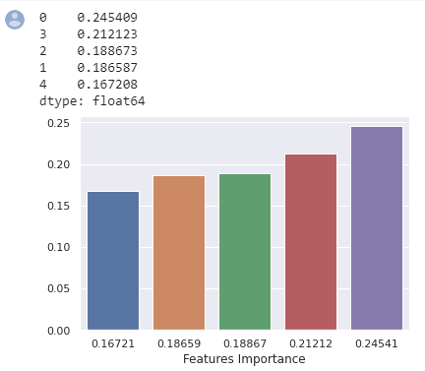
Analyze: Random Forest
Accuracy : 58.8%
3 example platforms shows that Global sales goes increases when North America Sales increases.
NA Sales and Global Sales are the most important features to predict the sales

Slide 14
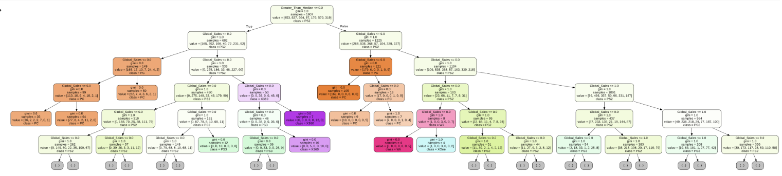
Analyze: Random Forest
PS (PS2, PS3, PS4) platforms mostly dominated the decision at the end

Slide 15
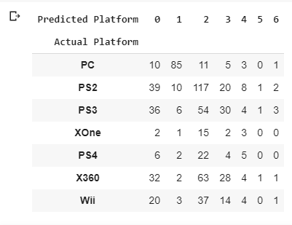

Analyze: Random Forest
Accuracy : 36.2% for the classifier
Global sales has higher impact on making decisions.

Slide 16
Recommend : Data Answers
Can we accurately predict the sales of a game in Global?
Can we predict whether a game will sell above or below the median price?
What is the best model to predict sales of games in the world?
Which platform will produce the most future Sales?
With the models and data we have we are not able to accurately determine how well a game will sell in term of exact dollars.
Yes we can predict this with an accuracy of 82%
The best model to predict above or below median sales is Logistic Regression.
A newer platform according to out data Sony is the best seller (PS4), PC also will forever be a platform of choice.

Slide 17

Recommendation: Conclusion
Video Games Developers should target Rating, Genre, and Platform.
Genre associated with Adults will have higher likelihood of sales.
Logistics Regression performed well, 82% accurate.
Logistic Regression Improved to 91-93% by grouping platforms.
Random Forest performed well but not as well as Logistic Regression.
Regressor 58%
Classifier 36%
Naive Bayes was 49% accurate.
Linear Regression was 47% accurate.

Slide 18
Recommendation: Room for improvement
The data is very incomplete (i.e Global Sales does not equal sum of all continents sales)
Revenue over time is missing. All revenues are tied to the year the game was released. Would be good to see timing of revenues
Could have used a binning for sales (High, Medium, Low)
Have more up-to-date data
Platforms have product life cycles, connecting consoles and their influences across time.
Add Mobile Gaming titles to compare. Most Mobile Games are free, but have in-game purchase amounts. Reviewing total revenue per game title and platform may give us a better picture of the Video Game Industry.

Slide 19
Thank you

